Slide 1


G H PATEL COLLEGE OF ENGINEERING & TECHNOLOGY
(THE CHARUTAR VIDYA MANDAL (CVM) UNIVERSITY)
Department of Information Technology
“AIML INTERN ”
Industrial Internship (202000801)
First Presentation
17th January , 2026
Presented By
External Guide
Internal Guide
Het Meghani
12202110501023
CSE(IoT) , GCET
Ms. Chandani Patel
Team Head
Mindstien Technologies , Rajkot
Prof. Prem Balani
IT Department, GCET,
Vallabh Vidyanagar

Slide 2
Outline
Offer Letter
Company’s Overview
Role As An AIML Intern
Work Completed
Logbook
12202110501023
AIML INTERN

Slide 3
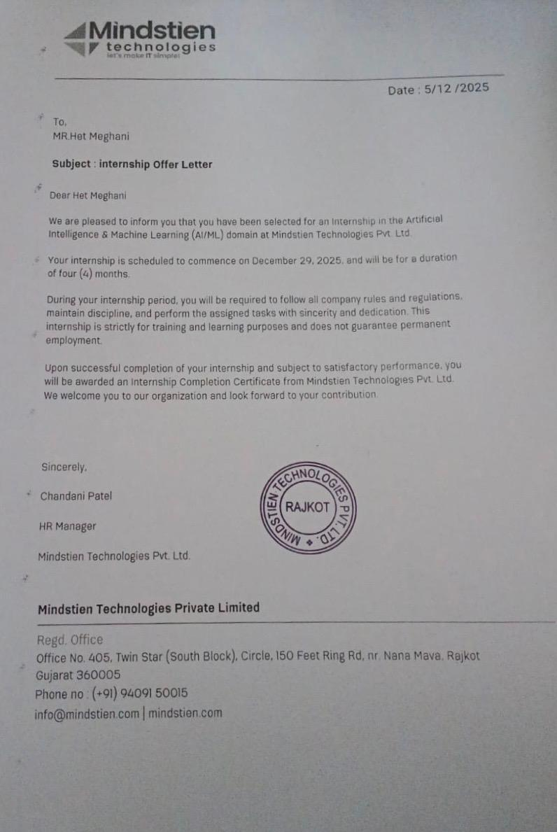
Offer Letter
12202110501023
AIML INTERN

Slide 4
Company’s Overview
Company Name : Mindstrein Technologies Pvt. Ltd.
Rajkot-based IT & Software Solutions Company
Focuses on Digital Transformation & Automation
Provides Custom Software Development
Works with AI/ML, IoT, CRM, and ERP solutions
Delivers practical, business-oriented technology solutions
Emphasizes real-world implementation and modern technologies
12202110501023
AIML INTERN

Slide 5
Role As An AIML Intern
Undergoing conceptual training and hands-on implementation
Learning Python and SQL as core AI/ML foundation skills
Using SQL for data storage, querying, and preprocessing
Using Python for logic building and data handling
Preparing for Machine Learning model development
12202110501023
AIML INTERN

Slide 6
Work Completed
SQL
SQL Fundamentals
Data Retrieval
Data Manipulation
Aggregate Functions
Grouping Data
Joins
Subqueries
Constraints & Keys
Python
Python Basics
Control Structures
Data Structures
Functions & Modules
File Handling
Error & Exception Handling
Python Libraries
NumPy
Pandas
Matplotlib
Seaborn
Scikit-learn
SciPy
12202110501023
AIML INTERN

Slide 7
Logbook
Link : month 1 Loogbook.pdf
12202110501023
AIML INTERN

Slide 8
Thank You…
12202110501023
AIML INTERN

